Slide 1

Eventology: A Smart Event Management Platform for College Events
Project Presentation
ADT23SOCB1335:- Yana Trivedi
ADT23SOCB0467:- Jaival Tamakuwala
ADT23SOCB1336 :- Yash Kumar
ADT23SOCB1266:-Vanshika Chopade
Guided by:
Prof. Dr. Rashmi Nair
Department of Computer Science & Engineering, MITSoC, Loni Kalbhor

Slide 2
Outline
Introduction
Problem Statement
Objectives
Concepts & Methods
Literature Review
Identification of gaps & scope of work
Implementation
Reference
Q&A
Department of Computer Science & Engineering, MITSoE, Loni Kalbhor

Slide 3
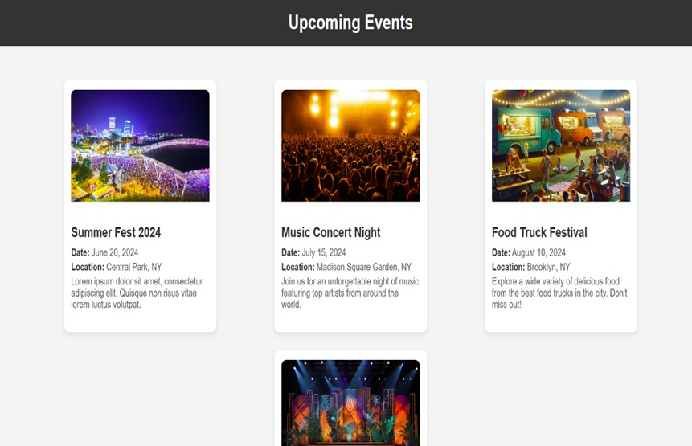
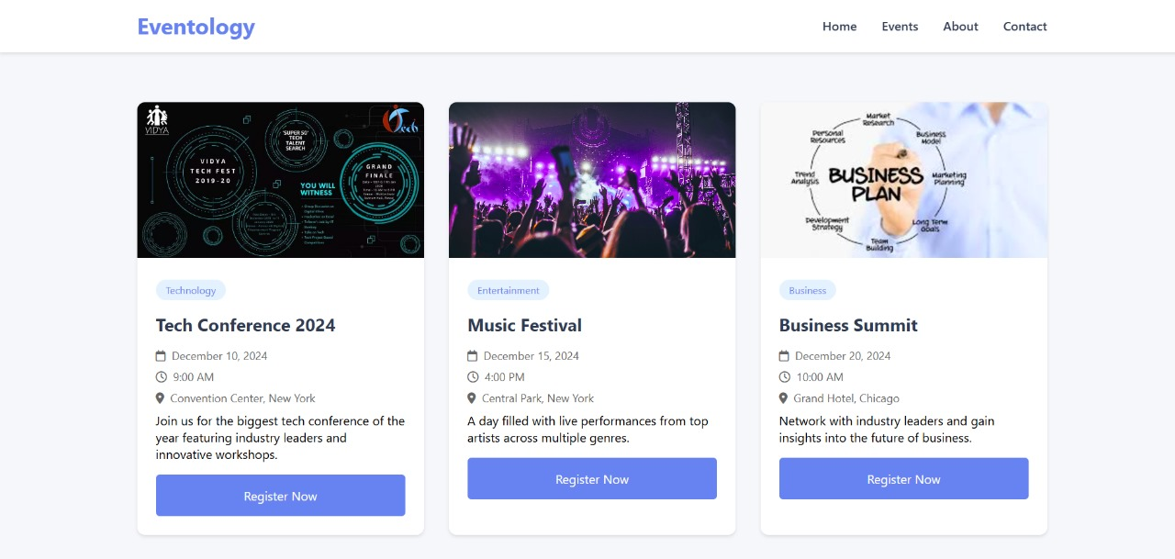
Introduction
Eventology is an innovative event management platform crafted for seamless organization and management of college events. Developed using HTML, CSS, and Flask, it offers an intuitive interface where users can browse and register for events effortlessly. The platform is designed to send timely notifications to participants, ensuring they remain informed about their commitments. For event managers, Eventology simplifies tasks by providing tools for creating, editing, and monitoring events without hassle. This structured, digital approach minimizes manual processes, reduces miscommunication, and enhances student engagement by making event participation more accessible and interactive.
Department of Computer Science & Engineering, MITSoC, Loni Kalbhor

Slide 4
Problem Statement
Current Challenge: College event promotion is often manual, leading to inefficiencies in event management and participant engagement.
Impact: Limited reach and attendance, and high administrative workload.
Proposed Solution: A centralized platform that automates event registration, reminder notifications, and event management.
Objectives
User Goals:
View upcoming events and register for them.
Receive reminders for registered events.
Admin Goals:
Create, edit, and manage event details.
Track registrations and send notifications.
Platform Goals:
Ensure a user-friendly interface and secure data handling.
Provide seamless communication between frontend and backend components.
Department of Computer Science & Engineering, MITSoC, Loni Kalbhor

Slide 5
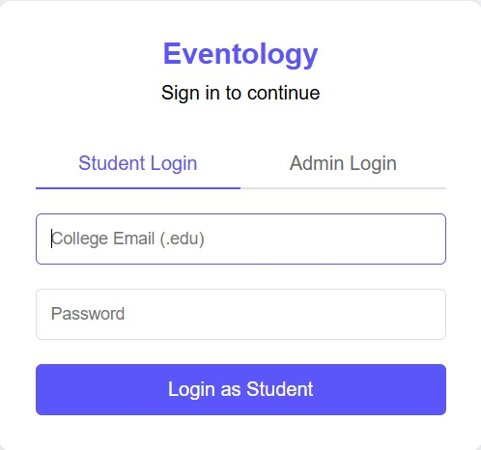
4. Concepts and Methods
Frontend: HTML,CSS for building interactive user interfaces.
Backend: Flask for creating RESTful APIs and managing data.
Database: SQLALCHEMY for structured data storage.
Authentication: Implementation of JWT or session-based authentication for secure login.
Data Flow: User interactions trigger API calls from HTML to Flask, which processes and returns data to be displayed.
Department of Computer Science & Engineering, MITSoC, Loni Kalbhor

Slide 6
5. Literature Survey
Sr. no | Literature Title | Author | Findings
1. | A Review of Event Management Systems: Current Technologies and Challenges | Dr. R. Sharma | Existing event systems are expensive. Complex interfaces hinder smaller institutions. Customizable, lightweight solutions are needed.
2. | Event Management Software in Higher Education Institutions | Prof. L. Chen | Current systems don't cater to college-specific requirements. Lightweight frameworks offer more flexibility. Simple backends improve system customization.
3. | "Simplifying Event Registration Processes: A Case Study" | M. Patel | Simple designs increase user engagement. HTML and CSS enhance front-end usability. Flask simplifies back-end development and integration.
Department of Computer Science & Engineering, MITSoC, Loni Kalbhor

Slide 7
6. Tools and Languages
Frontend Technologies: HTML and CSS are used for structuring and styling the user interface, ensuring a responsive and visually appealing platform for both users and admins.
Backend Framework: Flask, a lightweight Python web framework, is used for managing the backend logic, routing, and handling API requests for events and user registration.
Database: SQLite is used for storing event data, user details, and registration information in a simple yet effective relational database.
Notification System: Python's smtplib library is utilized to send email notifications to users for event reminders and updates.
Department of Computer Science & Engineering, MITSoC, Loni Kalbhor

Slide 8
7. Process and Architecture
Process:
The development process starts with requirement gathering and UI/UX design, followed by frontend and backend development using HTML, CSS, Flask, and SQLite. Testing and deployment follow, with ongoing maintenance to improve the platform based on feedback.
2. Architecture:
Eventology uses a Flask backend to manage data and business logic, with an HTML/CSS frontend. User and event data are stored in an SQLite database, and notifications are sent using Python libraries for automation.
3. Scalability and Security:
The platform incorporates secure user authentication and is built to scale, with plans to integrate ReactJS for the frontend and potentially upgrade the database system for better performance.
Department of Computer Science & Engineering, MITSoC, Loni Kalbhor

Slide 9
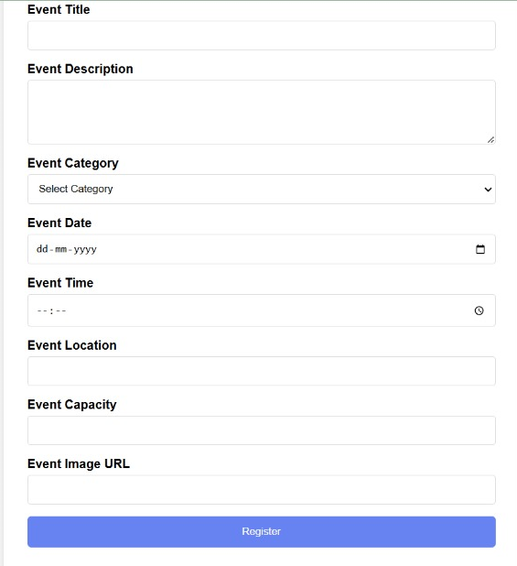
WORKFLOW:
1.User Registration
- Users sign up and create profiles on the platform.
2. Event Manager Login
- Event managers log in to upload and manage event details.
3. User Registration for Events
- Users register for events they are interested in.
4. Automated Notifications
- The platform sends email reminders to registered users using Flask-SMTP.
5. Feedback and Engagement Analytics
- Platform collects engagement metrics for improvement.
6. Database Management
- Stores user and event data using **Flask-SQL.
7. Platform Updates
- Updates and optimizations are made based on admin and user feedback. .
Department of Computer Science & Engineering, MITSoC, Loni Kalbhor

Slide 10
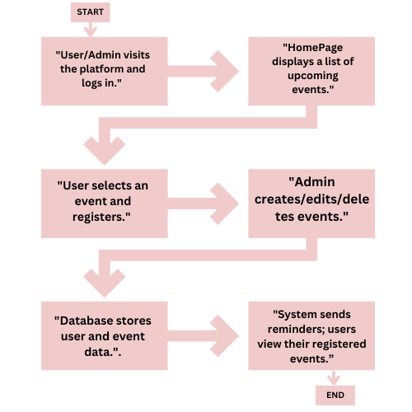
FLOWCHART:
Department of Computer Science & Engineering, MITSoC, Loni Kalbhor

Slide 11
Identification of gaps & scope of work
Identification of Gaps
Lack of a centralized event platform.
Manual registration processes.
Ineffective event notifications.
Overlapping event schedules.
Scattered event data management.
Scope of Work
Develop a unified event platform.
Automate participant notifications.
Create user-friendly dashboards.
Integrate with existing college systems.
Add engagement tracking features.
Department of Computer Science & Engineering, MITSoC, Loni Kalbhor

Slide 12
8. Implementation
Frontend Development:
- Create HTML and CSS components: HomePage, UserDashboard, AdminDashboard, EventDetails.
- Use hyperlinks and navigation bars for internal navigation between pages.
Backend Setup:
- Create Flask endpoints: `/events`, `/register`, `/admin/events`.
- Ensure proper routing and request handling for dynamic content.
Database Design:
- Use SQLite for data storage and integrate SQLAlchemy for ORM-based database interaction.
Authentication:
- Implement session-based authentication for user login and session management to secure routes and data.
Department of Computer Science & Engineering, MITSoC, Loni Kalbhor

Slide 13
9. Results
Enhanced Event Participation: Eventology facilitates increased participation through streamlined registration and automated reminders, boosting attendance rates at college events.
User Satisfaction: A user-friendly platform enhances the experience for students, leading to positive feedback and repeated use for future events.
Expanded User Base: The platform attracts more users by simplifying event discovery and management, contributing to broader engagement across the college.
Improved Event Management: Event managers benefit from a seamless interface for organizing and updating event details, reducing manual workload and errors
Department of Computer Science & Engineering, MITSoE, Loni Kalbhor

Slide 14
10. Conclusion and Future Work
Conclusion:
Eventology has proven to be an effective solution for managing college events, streamlining event registration, and enhancing communication. By automating notifications and providing an easy-to-use interface, the platform has improved both user engagement and event manager efficiency. The initial deployment has demonstrated its potential to simplify event coordination and increase student participation.
Future Work:
Future improvements will include expanding features such as real-time event updates, integrating a feedback mechanism for attendees, and developing a mobile application for better accessibility. Additionally, incorporating analytics to measure event success and further enhance user experience will be prioritized, along with exploring AI-driven recommendations for personalized event suggestions.
Department of Computer Science & Engineering, MITSoC, Loni Kalbhor

Slide 15
References
1. [1Perez, M. R. L., Lagman, A. C., & Adao, R. T. (2017, December). Event management solution using web application platform. In Proceedings of the 2017 International Conference on Information Technology (pp. 206-211).
2. Salam, A., & Hajriyanti, R. (2022). Event Management System for Webinars and Survey. International Journal Software Engineering and Computer Science (IJSECS), 2(1), 9-17
3. Shah, D. A., Vasudavan, H., & Razali, N. F. (2023). Event Management Systems (EMS). Journal of Applied Technology and Innovation, 7(2), 45-53.
Department of Computer Science & Engineering, MITSoE, Loni Kalbhor

Slide 16
Thank You
Department of Computer Science & Engineering, MITSoC, Loni Kalbhor

